Slide 1

CPS 109 Lab 7
Gurpreet kaur
Mojan nooshin Habibi

Slide 2
Agenda
Discussion of Quiz 6
“Finally” Keyword
Dictionaries in Python
Examples
Quiz

Slide 3
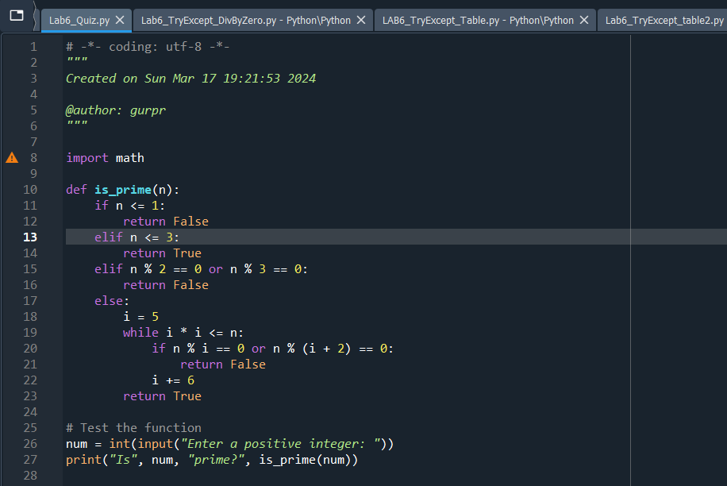
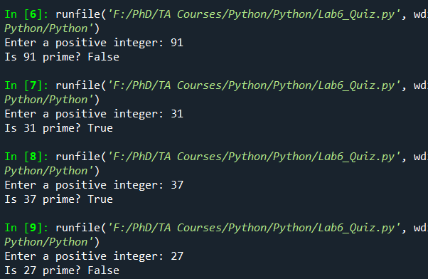
Quiz 6

Slide 4
Finally Clause
The finally code is also a part of exception handling.
Finally block could be added at the end of try and except block
The “finally” block is always executed so it is generally used for concluding tasks like closing file resources, database connections or just to end execution with a message

Slide 5
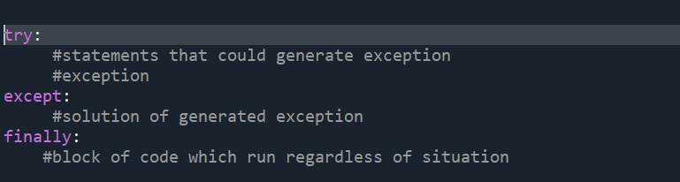
Syntax

Slide 6
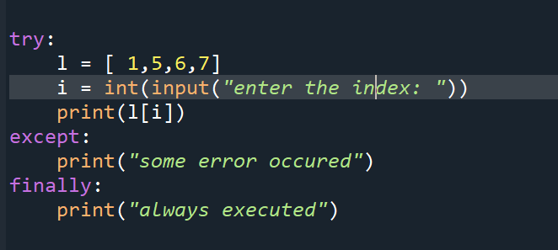
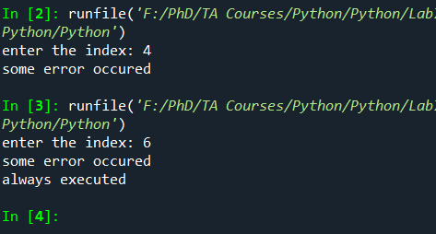
Example

Slide 7
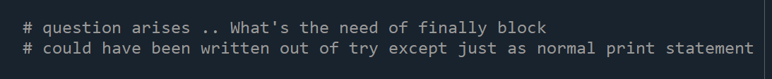
Question??

Slide 8
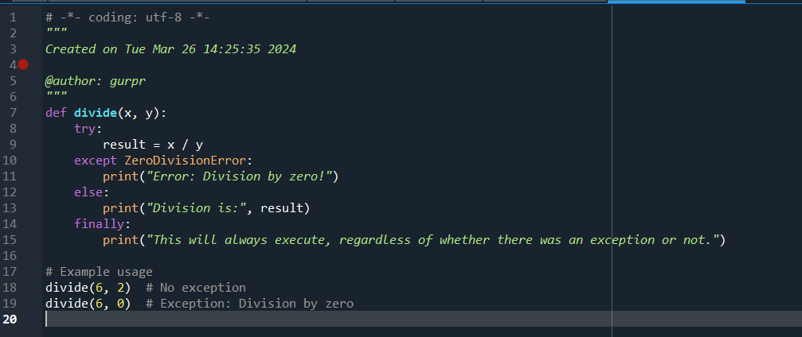
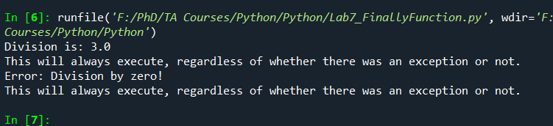
Lets see and understand :FinallyFunction.py

Slide 9
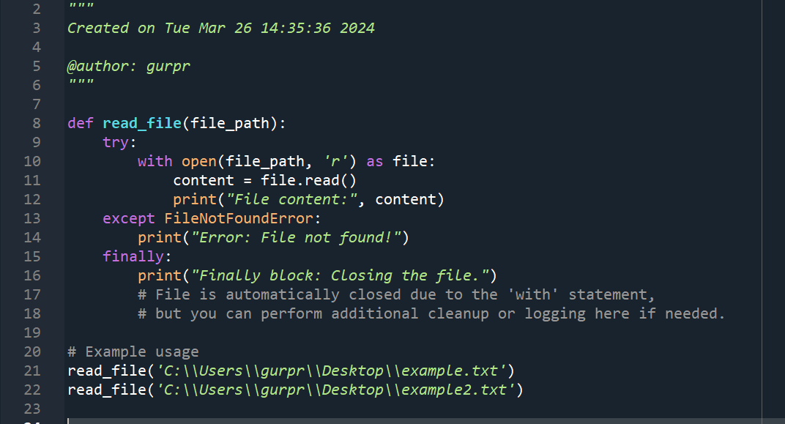
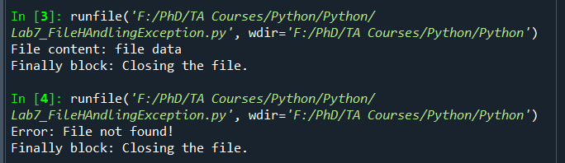
Example: FileHandlingException.py

Slide 10
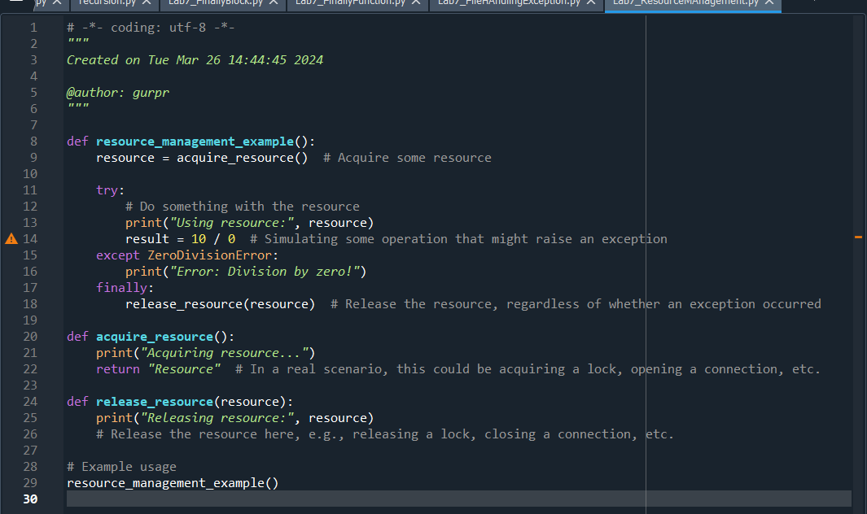
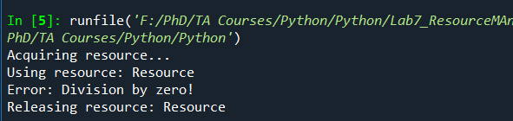
Example: resourcemanagement.py

Slide 11
Intro to Dictionaries in Python
Dictionaries are ordered collection of data items .
They store multiple items in a single variable.
Dictionary items are key value pairs ; separated by commas and enclosed within {}.

Slide 12
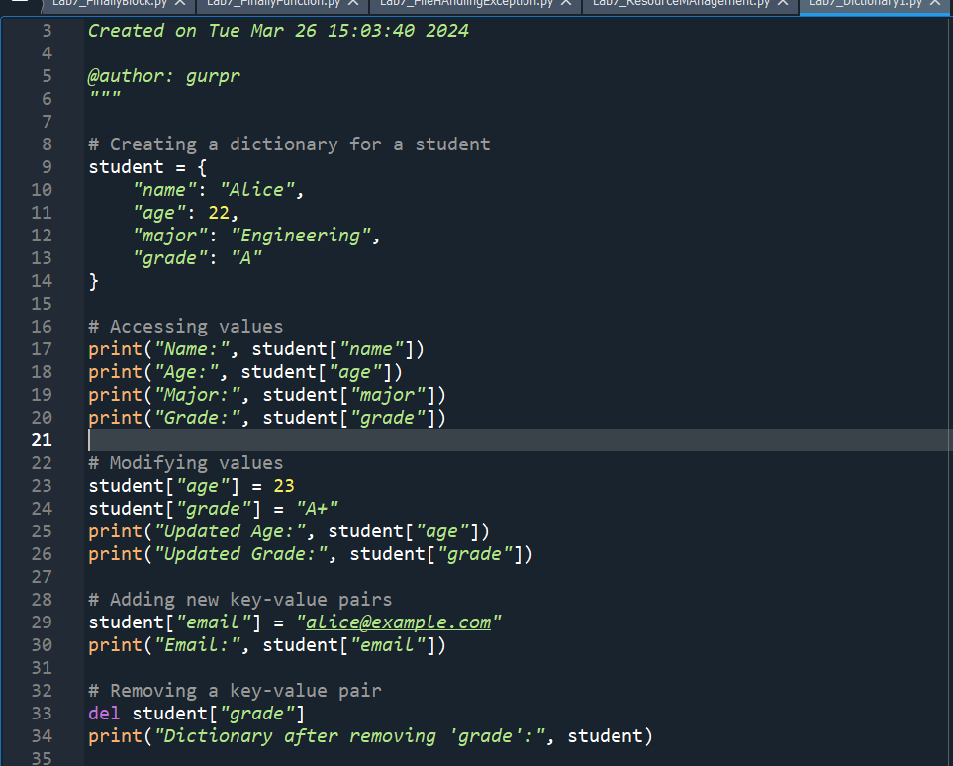
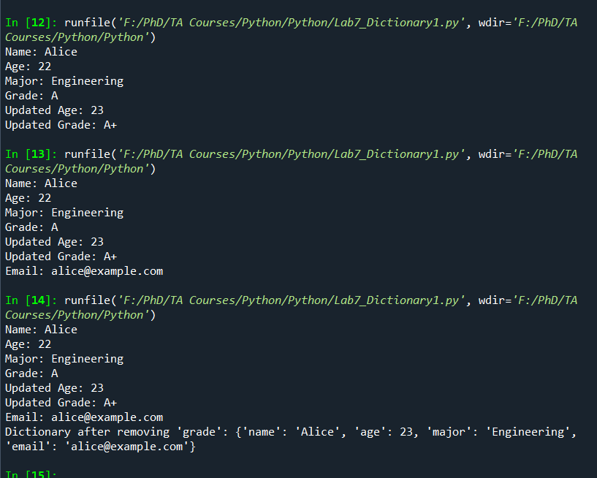
Example : Dictionary1.py

Slide 13
Continued by Mojan
More Live examples ..

